Slide 1
Set Operations
Course Code: CSC 1204
Course Title: Discrete Mathematics
Dept. of Computer Science
Faculty of Science and Technology
Lecturer No: | 8 | Week No: | 4 | Semester: | Summer 20_21
Lecturer: | Nazia Hossain

Slide 2
Lecture Outline
2.2 Set Operations
Union ( ∪ )
Intersection ( ∩ )
Disjoint Sets
Principle of inclusion-exclusion
Difference (“− ”)
Complement(“‾ ”)
Symmetric Difference ( ⊕ )
Set Identities
Computer Representation of Sets

Slide 3
Objectives and Outcomes
Objectives: To understand different types of set operations, to understand various ways of representing sets using a computer.
Outcomes: Students are expected to be able to perform different types of set operations, be able to represent a set with a computer.

Slide 4
Union of Sets
Definition: Let A and B be sets. The union of the sets A and B, denoted by A U B, is the set that contains those elements that are either in A or in B, or in both.
An element x belongs to the union of the sets A and B if and only if x belongs to A or x belong to B. This tells us that
A ∪ B = { x | x∈A ∨ x∈B }
Example 1: The union of the sets {1, 3, 5} and {1, 2, 3} is the set {1, 2, 3, 5}; that is, {1,3, 5} U {1, 2, 3} = {1, 2, 3, 5}
Example 2: If A = {Cyndi, Faisal, Abdullah}, and B ={Laila, Rahim}, then, A ∪ B = {Cyndi, Faisal, Abdullah, Laila, Rahim}

Slide 5
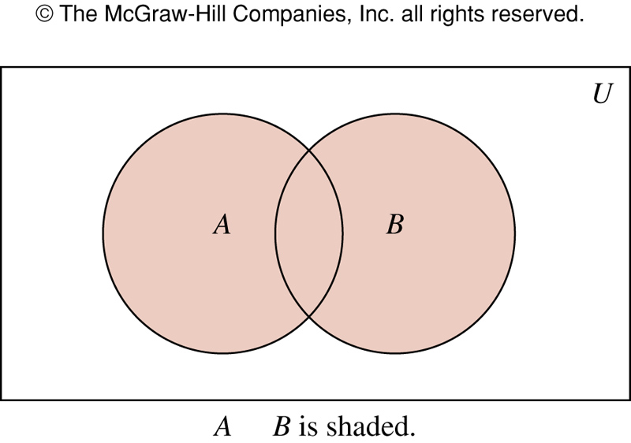
FIGURE 1 Venn Diagram Representing the Union of A and B.

Slide 6
Intersection of Sets
Definition : Let A and B be sets. The intersection of the sets A and B, denoted by A∩B, is the set containing those elements in both A and B.
An element x belongs to the intersection of the sets A and B if and only if x belongs to A and x belongs to B
A ∩ B= { x | x ∈ A ∧ x ∈ B}
Example 3: The intersection of the sets {1, 3, 5} and
{1, 2, 3} is the set {1, 3}; that is, {1,3, 5} ∩ {1, 2, 3} = {1, 3}.
Example : If B = {x | x is an odd positive integer and x ≤ 5}, and
C = {x | x is a prime number less than 11}, then
B ∩ C = {3, 5}

Slide 7
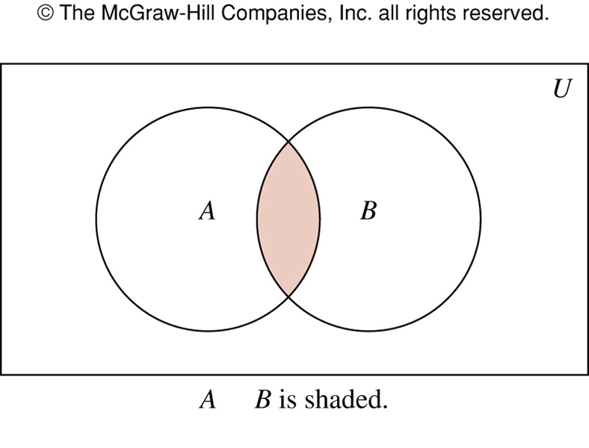
FIGURE 2: Venn Diagram Representing the Intersection of A and B

Slide 8
Disjoint Sets
Definition: Two sets are disjoint if their intersection is the empty set.
Let A and B be sets. If A ∩ B = ∅ , that is if A and B do not have any element(s) in common, then A and B are said to be disjoint or non-intersecting.
Disjoint ==> Non-intersecting
Example 5: Let A = {1, 3, 5, 7, 9} and B = {2, 4, 6, 8, 10}. Because A ∩ B = ∅, A and B are disjoint.

Slide 9
Venn Diagram showing Disjoint of the two sets A and B
U
B
A

Slide 10
Principle of inclusion-exclusion
Question: How many elements are there in the union of two sets A and B? Or, What is the cardinality of a union of two sets A and B?
Answer: The number of elements in the union of the two sets is the sum of the number of elements in the sets minus the number of elements in their intersection.
|A∪B| = |A| + |B| - | A ∩ B |
The generalization of this result to unions of an arbitrary number of sets is called the Principle of inclusion-exclusion

Slide 11
A ={1,2,3}, B={1,3,5}
|A∪B| = |A| + |B| - | A ∩ B |
= 3 + 3 – 2
= 4
A U B = {1,2,3,5}

Slide 12
Difference of Two Sets
Definition : The difference of the sets A and B, denoted by A – B, is the set containing those elements that are in A but not in B.
An element x belongs to the difference of A and B if and only if x∈ A and x∉ B. This tell us that
A – B = { x| x∈ A ∧ x∉ B }
The difference of A and B is also called the complement of B with respect to A.
A – B = A ∩ B

Slide 13
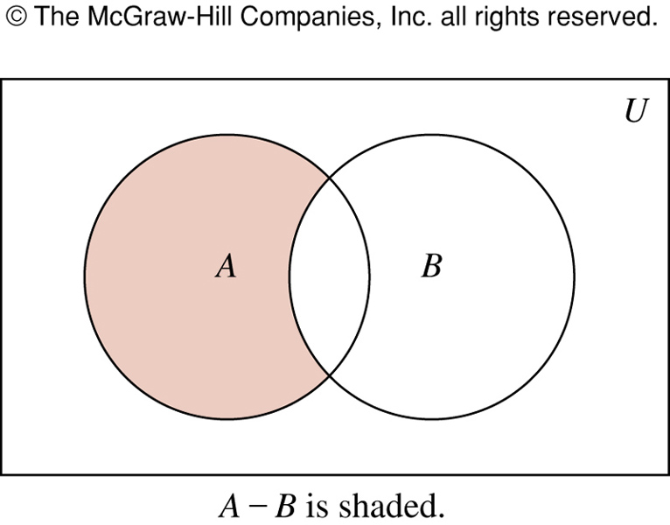
FIGURE 3: Venn Diagram for the Difference of A and B

Slide 14
Difference of Two Sets: Examples
Example 6: The difference of {1, 3, 5} and {1, 2, 3} is the set {5}; that is, {1, 3, 5} – {1, 2, 3} = {5}.
Note: This is the different from the difference of
{1, 2, 3} and {1, 3, 5} which is the set {2}.
{1, 2, 3} – {1, 3, 5} = {2}.
Example : Let A = { a, b, c} and B = { b, c, d, e }.
A – B = { a }
B – A = { d, e }

Slide 15
Complement of a Set
Definition: Let U be the universal set. The complement of the set A, denoted by Ā, is the complement of A with respect to U.
An element x belongs to Ā if and only if x∉A
Ā = { x | x∉A }
In other words, the complement of the set A is U – A,
Ā = U – A
Practice yourself: Example 8 & Example 9

Slide 16
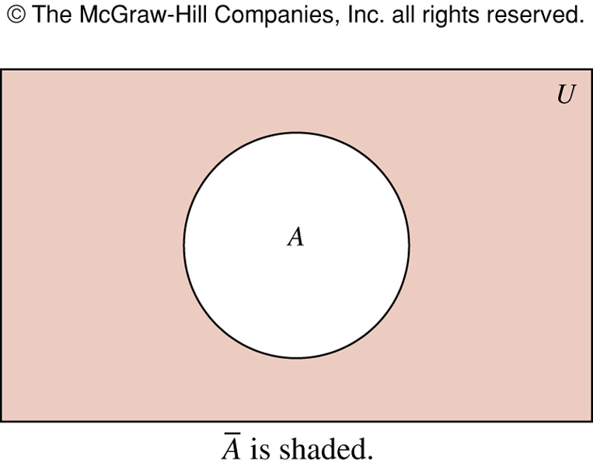
FIGURE 4: Venn Diagram for the Complement of the Set A
‾A

Slide 17
Symmetric difference of Two Sets
Definition: The symmetric difference of two sets A and B, denoted by A ⊕ B, is the set of elements that belongs to A or to B, but not to both A and B.
A ⊕ B = The set containing those elements in exactly one of A and B.
A ⊕ B = { x | (x ∈ A ∧ x ∉ B) v (x ∈ B ∧ x ∉ A) }
= (A – B) U (B – A)
Example: If A = { -3, 0, 1, 2} and B = { 1, 2, 3, 4 }, then A ⊕ B = { -3, 0, 3, 4}
Alternate Solution: A – B = { -3, 0 } and B – A = { 3, 4 }.
Therefore, A ⊕ B = (A - B) U (B - A) = { -3, 0, 3, 4 }

Slide 18
Figure: Venn Diagram for The Symmetric Difference of two sets A and B, A ⊕ B
U
A
B

Slide 19
Set Identities
To prove set identities:
Show that each is a subset of the other
Show that A ⊆ B and that A ⊇ B
Using membership tables
Like truth tables
Use logical equivalences to prove equivalent set definitions

Slide 20
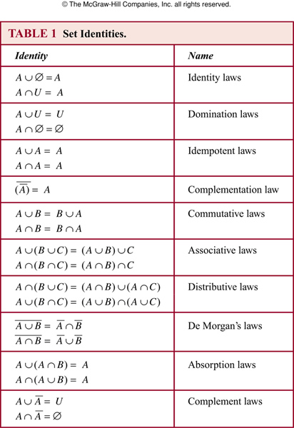
Set Identities

Slide 21
Set Identities
This table is gotten from the previous table(TABLE 6, page 24) of logical identities by rewriting as follows:
Disjunction “∨” becomes union “∪”
Conjunction “∧” becomes intersection “∩”
Negation “¬” becomes complementation “–”
False “F” becomes the empty set ∅
True “T” becomes the universal set U

Slide 22
Membership Table
Membership Table: A table displaying the membership of elements in sets.
Example 13: Use membership table Show that
A ∩ (B ∪ C) = (A ∩ B) ∪ (A ∩ C).

Slide 23
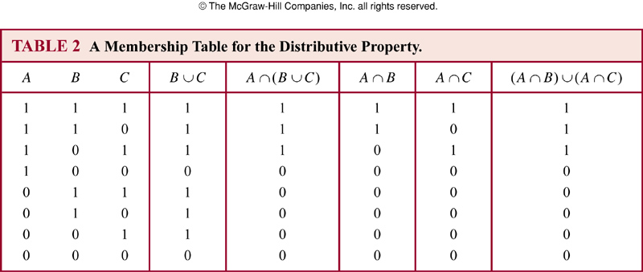
Solution of Example 13

Slide 24
Set Identities
Prove that (A U B) = A ∩ B using a membership table.
A | B | A | B | A ∩ B | A U B | A U B
1 | 1 | 0 | 0 | 0 | 1 | 0
1 | 0 | 0 | 1 | 0 | 1 | 0
0 | 1 | 1 | 0 | 0 | 1 | 0
0 | 0 | 1 | 1 | 1 | 0 | 1

Slide 25
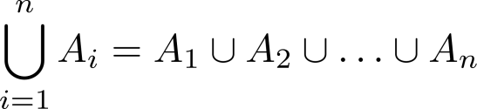
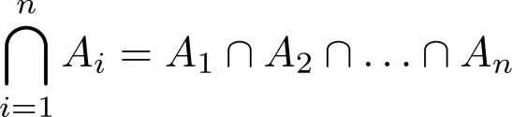
Generalized Unions and Intersections
Definition : The union of a collection of sets is the set containing those elements that are members of at least one set in the collection.
Definition: The intersection of a collection of sets is the set containing those elements that are members of all the sets in the collection.

Slide 26
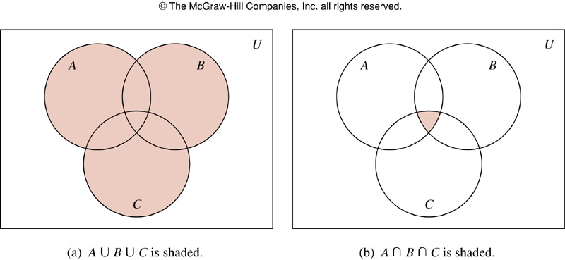
FIGURE 5: The Union and Intersection of A, B, and C

Slide 27
Example: Union and Intersection of three sets
Example 15 : Let A = { 0, 2, 4, 6, 8}, B = {0, 1, 2, 3, 4}, and C = { 0, 3, 6, 9}. What are A U B U C and A ∩ B ∩ C ?
Solution:
A U B U C = { 0, 1, 2, 3, 4, 6, 8, 9}
A ∩ B ∩ C = { 0 }
Class Work: Show the above sets in a Venn Diagram.
Assume universal set U.

Slide 28
Computer Representation of Sets
There are various ways to represent sets using a computer. One method is to store the elements of the set in an unordered fashion. However, if this is done, the operations of computing the union, intersection, or difference of two sets would be time-consuming, because each of these operations would require a large amount of searching for elements.
We use a method for storing elements using an arbitrary ordering of the elements of the universal set. This method of representing sets makes computing combinations of sets easy.

Slide 29
Example 18
Let U = { 1, 2, 3, 4, 5, 6, 7, 8, 9, 10 }
What bit string represents the subset of all odd integers in U?
What bit string represents the subset of all even integers in U?
What bit string represents the subset of integers not exceeding 5 in U?
Solution:
{ 1, 3, 5, 7, 9 } ==> 1010101010
{ 2, 4, 6, 8, 10} ==> 0101010101
{ 1, 2, 3, 4, 5} ==> 1111100000

Slide 30
Example 19
What is the bit string for the complement of the set { 1, 3, 5, 7, 9}, where U = { 1, 2, 3, 4, 5, 6, 7, 8, 9, 10 }?
Solution:
The bit string for the set { 1, 3, 5, 7, 9} is 1010101010.
The bit string for the complement of this set is obtained by replacing 0s with 1s and vice versa.
This yields the string 0101010101 which corresponds to the set
{ 2, 4, 6, 8, 10 }

Slide 31
Practice @ Home
Relevant odd-numbered Exercises from your text book

Slide 32
Books
Discrete Mathematics and its applications with combinatorics and graph theory (7th edition) by Kenneth H. Rosen [Indian Adaptation by KAMALA KRITHIVASAN], published by McGraw-Hill

Slide 33
References
Discrete Mathematics, Richard Johnsonbaugh, Pearson education, Inc.
Discrete Mathematical Structures, Bernard Kolman, Robert C. Busby, Sharon Ross, Prentice-Hall, Inc.
SCHAUM’S outlines Discrete Mathematics(2nd edition), by Seymour Lipschutz, Marc Lipson

